Slide 1
Intron chain
Intron chain is the set of numbers corresponding to the start and end exon coordinates for spliced exons
Intron chain also records the strand (+, or forward) or (-, or reverse)
Intron chain here is (+) i₁, i₂, i₃, i₄, i₅, i₆
Ignores start and end coordinates
Coding start
Coding stop
i₁
i₂
i₃
i₄
i₅
i₆

Slide 2
Nucleotide level accuracy
TN
FN
TP
FP
TN
FN
TP
FN
TN
REALITY
ASSEMBLY
Sensitivity:
Precision:

Slide 3
Exon level accuracy
WRONG
EXON
CORRECT
EXON
MISSING
EXON
REALITY
ASSEMBLY
Exon Sensitivity
Exon Precision
“Junction ends” must match exactly, beginning or end do not!

Slide 4
Transcript level accuracy
< 80%
REALITY
ASSEMBLY
WRONG!
Same INTRON CHAIN => CORRECT!
CORRECT!

Slide 5
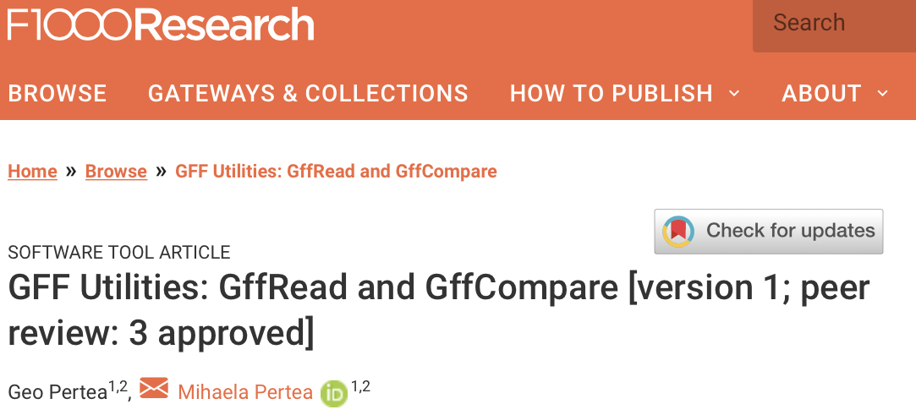
gffread, gffcompare and trmap
gffread, gffcompare and trmap
- a fast tool for verification, filtering and conversion of the most popular annotation file formats (GTF, GFF3, BED) and for quick extraction of transcript sequences from the genome sequence.
FASTA:
GFF/BED:
gffread -w
http://ccb.jhu.edu/software/stringtie/gff.shtml

Slide 6
gffread, gffcompare and trmap
gffread, gffcompare and trmap
- a tool for merging and tracking transcript structures across multiple samples and comparing them to a reference annotation.
exon 1
exon 2
exon 3
exon 4
Reference
transcripts
isoform 1
isoform 2
Sample 1
transfrags
Sample 2
transfrags
Merged
transcripts
http://ccb.jhu.edu/software/stringtie/gff.shtml

Slide 7
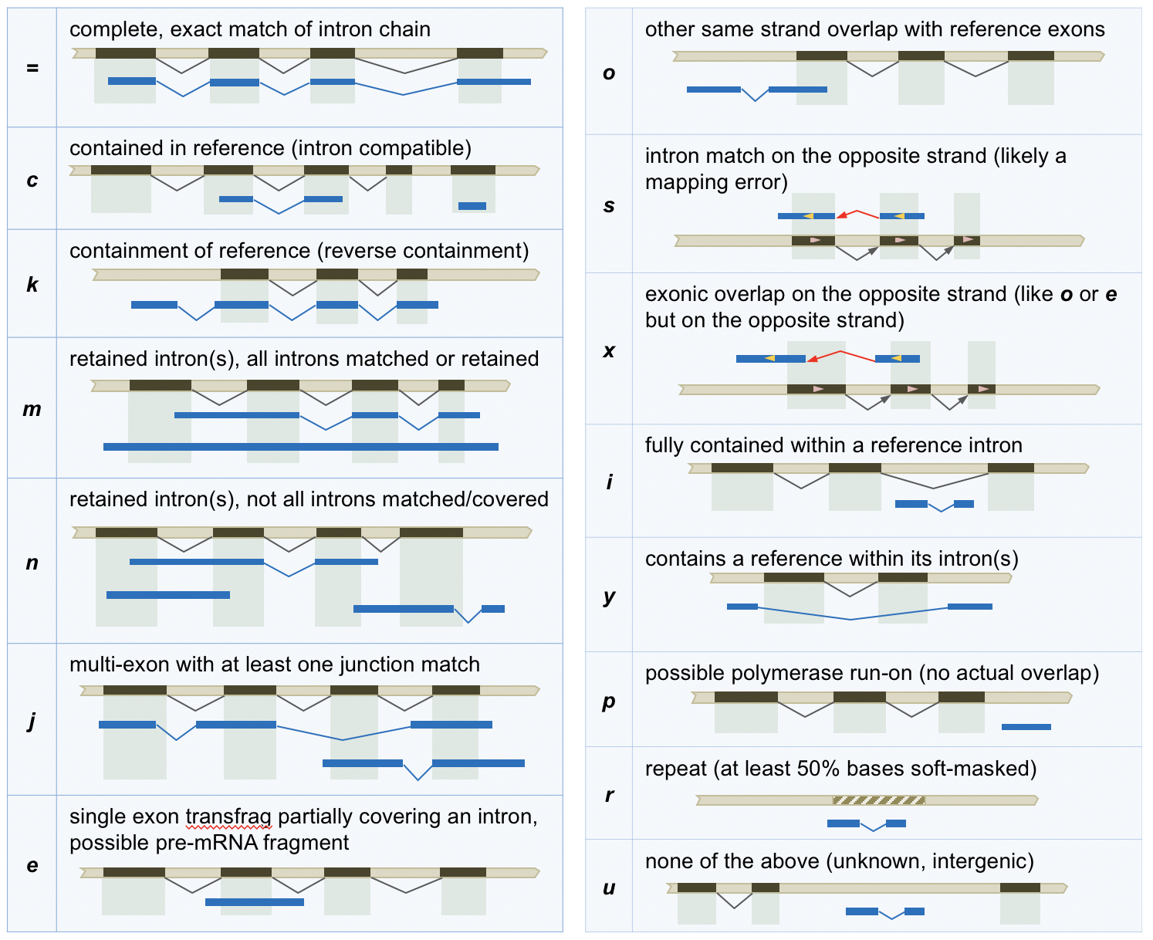
gffread, gffcompare and trmap
gffread, gffcompare and trmap
- a tool for merging and tracking transcript structures across multiple samples and comparing them to a reference annotation.
http://ccb.jhu.edu/software/stringtie/gff.shtml

Slide 8
gffread, gffcompare and trmap
gffread, gffcompare and trmap
- designed for large scale overlap analysis of streaming transcript prediction data (millions of transcripts) with a reference annotation data set; it performs detection and classification of all the overlaps found between the streamed transcripts and the reference annotation transcripts.
http://ccb.jhu.edu/software/stringtie/gff.shtml

Slide 9
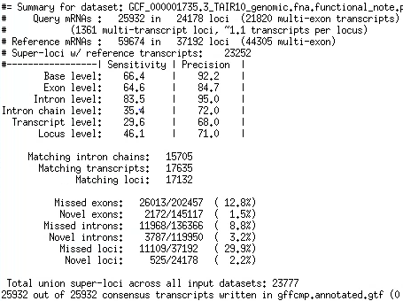
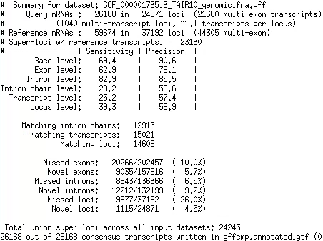
gffcompare of two annotations

Slide 10
gffcompare of two annotations

Slide 11
Ab initio gene finding
Transcriptome sequencing data does not provide comprehensive picture of expression – not all transcripts are expressed in all cells at the same time:
  Sequence many different cells under many conditions (expensive)
  Supplement transcriptome sequencing data with an ab initio gene finding algorithm to find transcripts that a not expressed
Assembled transcripts have errors:
  Use machine learning algorithms to detect errors in assembled transcripts
Machine learning:
  Positional Weights/Markov chain/Hidden Markov Models
  Convolution Neural Networks?

Slide 12
Machine learning algorithms
Protein coding and non-coding sequences have different patterns of letters
Spliceosome does not just cut out introns at GT-AG, it recognizes longer patterns around splice sites
We can look for the patterns with machine learning algorithms
We can model and test the patterns with:
  Positional Probabilities or Positional Weights
  Markov chains
  Hidden Markov Models

